Slide 1

Analyzing Mental Health Trends on TikTok
Independent Study Progress Update

Slide 2
Abstract
Overview:
This project investigates mental health dynamics on TikTok by analyzing text data (comments, transcriptions, hashtags, and video descriptions).
It uses topic modeling to extract key themes and sentiment analysis (including toxicity evaluation) to gauge the emotional tone in discussions.
Additional Angle:
Future explorations might include trend or network analysis, and assessing the influence of major events (e.g., elections) on user sentiment.

Slide 3
Project Overview
Objectives:
Analyze and uncover prevalent topics in TikTok videos related to mental health.
Assess sentiment and toxicity levels in user comments.
Scope:
Data extraction via TikTok API, extensive text preprocessing, and advanced analysis (topic modeling and sentiment analysis).

Slide 4
Week-by-Week Progress

Slide 5
Week 1 – Feb 13
Activities:
Explored the TikTok API to understand data availability.
Outcome:
Established groundwork for accessing TikTok data.

Slide 6
Week 2 – Feb 20
Activities:
Set up the server environment and performed initial data exploration.
Outcome:
Ensured infrastructure was in place for further processing.

Slide 7
Week 3 – Feb 25
Activities:
Converted JSON files (beginning with “mental”) into individual DataFrames.
Merged these into a combined DataFrame (combined_df).
Created a comprehensive text column by merging “video_description”, “hashtag_names”, and “voice_to_text.”
Applied text preprocessing and initiated topic modeling using CountVectorizer and LDA.
Outcome:
Established a unified dataset and preliminary topics.

Slide 8
Week 4 – March 4
Activities:
Enhanced text preprocessing by merging domain-specific stop words with default ones.
Experimented with various topic counts.
Developed a word importance score to refine and re-rank topic keywords.
Outcome:
Improved topic clarity and keyword relevance.

Slide 9
Week 5 – March 11
Activities:
Incorporated social media-specific stopwords into preprocessing.
Tested a TF-IDF vectorizer with NMF for topic modeling.
Experimented with BERTopic for leveraging transformer-based embeddings.
Outcome:
Explored alternative methods for topic extraction, enhancing analytical depth.

Slide 10
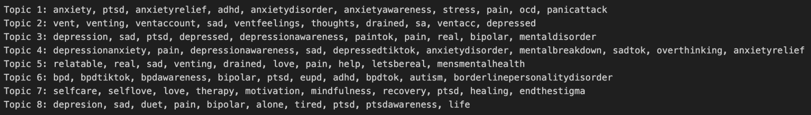
Top Words per Topic (NMF on TF-IDF Matrix)

Slide 11
Week 6 – March 20
Activities:
Conducted descriptive analysis on topics (average like count, view count, comment count, etc.).
Visualized top 5 region codes per topic.
Initiated comment extraction from TikTok via the Git repository.
Processed and compiled comments for the first 1500 video IDs.
Outcome:
Merged quantitative metrics with thematic data, laying the groundwork for sentiment analysis.

Slide 12
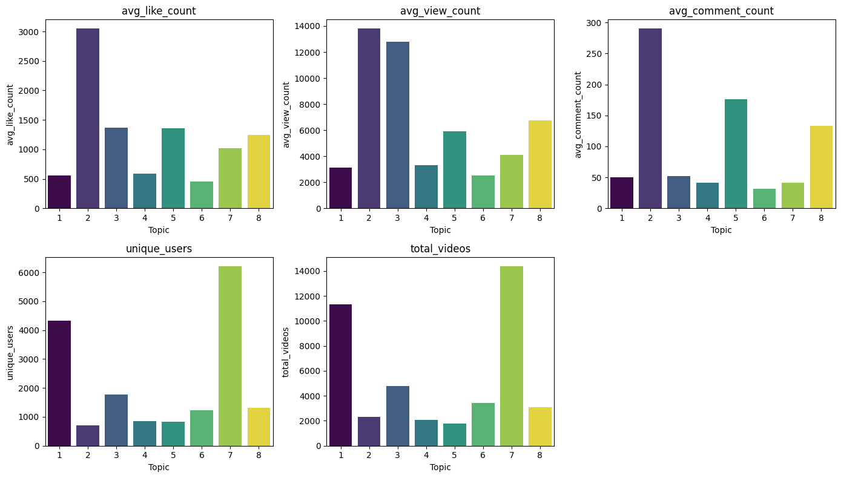
Descriptive Analytics by Topic

Slide 13
Week 7 – March 25
Activities:
Continued visualizing region code proportions.
Extracted and compiled comments for an additional 1500 videos (total 3000).
Performed sentiment analysis on these comments using VADER and Detoxify.
Outcome:
Developed sentiment profiles across topics, with toxicity insights.

Slide 14
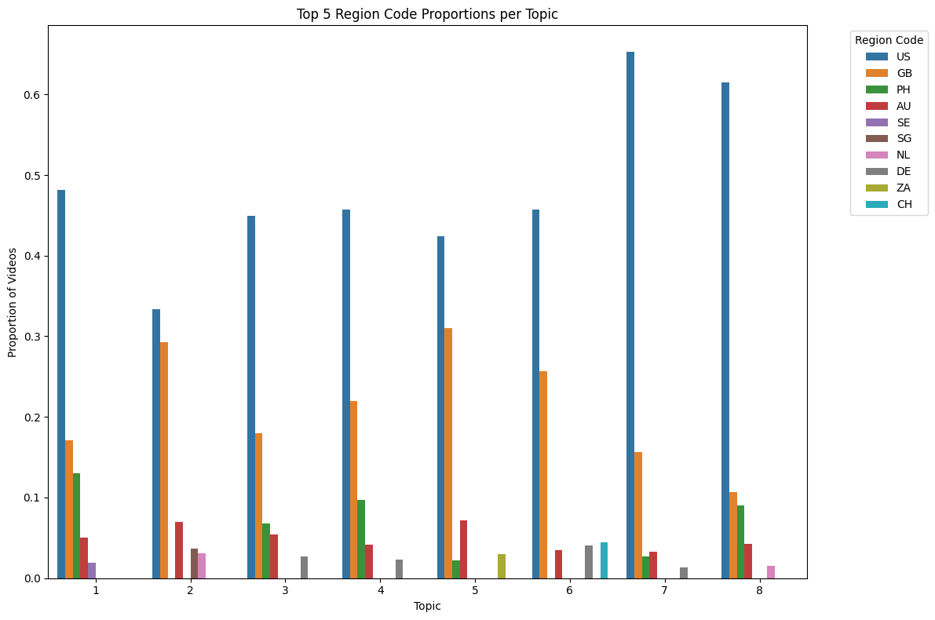
Top 5 Region Code Proportions per Topic

Slide 15
Week 8 – April 1
Activities:
Extracted comments for an additional 3000 video IDs (up to 6000).
Merged sentiment data with topic assignments.
Aggregated toxicity and polarity scores at the video and topic levels.
Visualized multiple aspects.
Average compound and toxicity scores by topic.
Distribution plots for both scores.
Comparison of video-level compound scores versus toxicity.
Outcome:
Achieved comprehensive sentiment insights linked to topic modeling.

Slide 16
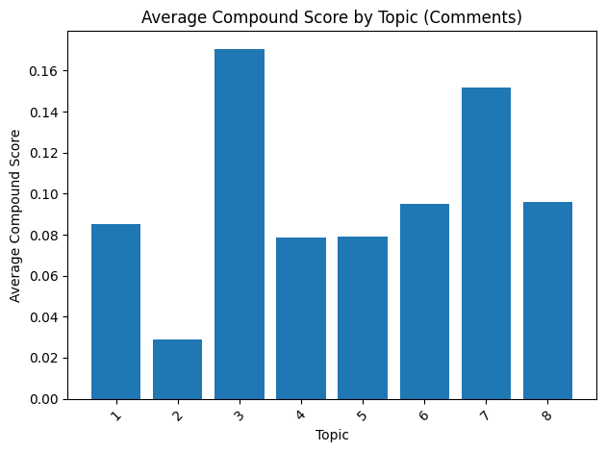
Average Compound Score by Topic (Comments)

Slide 17
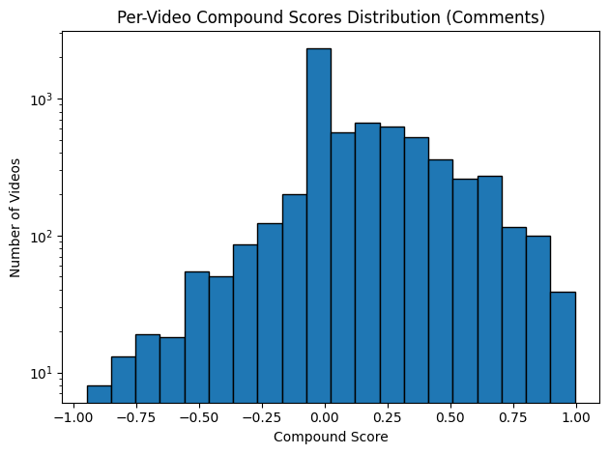
Per-Video Compound Scores Distribution (Comments)

Slide 18
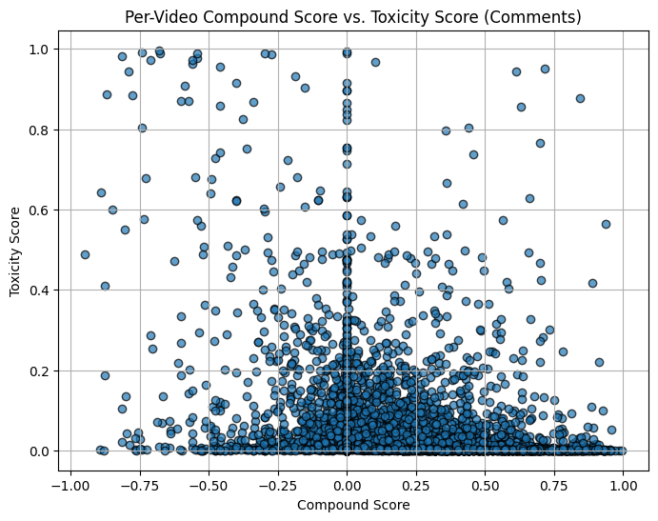
Compound Score vs. Toxicity Score

Slide 19
Week 9 – April 8
Activities:
Applied a log odds method on the NMF with TF-IDF vectorizer to rearrange topic keywords for improved discrimination.
Extracted comments for an additional 2,500 video IDs and combined them with the previous 3,000 video IDs DataFrame (totaling 8,500 video IDs).
Performed sentiment analysis on the updated comment dataset, visualizing severe toxicity, obscene, threat, insult, identity attack, and overall toxicity scores.
Conducted sentiment analysis on preprocessed text (from "video_description", "hashtag_names", and "voice_to_text") and visualized average compound and toxicity scores by topic.
Outcome:
Achieved enhanced topic clarity with more distinctive keywords.
Expanded dataset provided a richer sentiment analysis, yielding deeper insights into the mental health trends on TikTok.

Slide 20
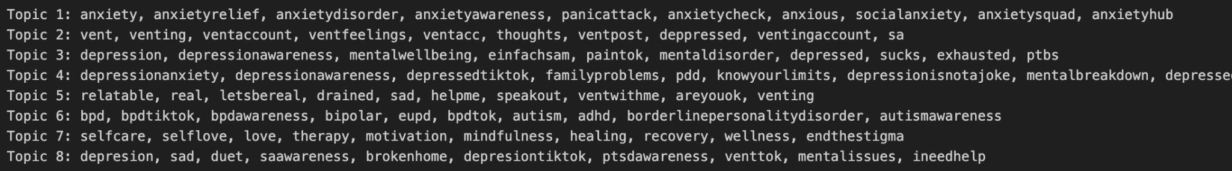
Refined Topic Words Using Log Odds (NMF + TF-IDF)

Slide 21
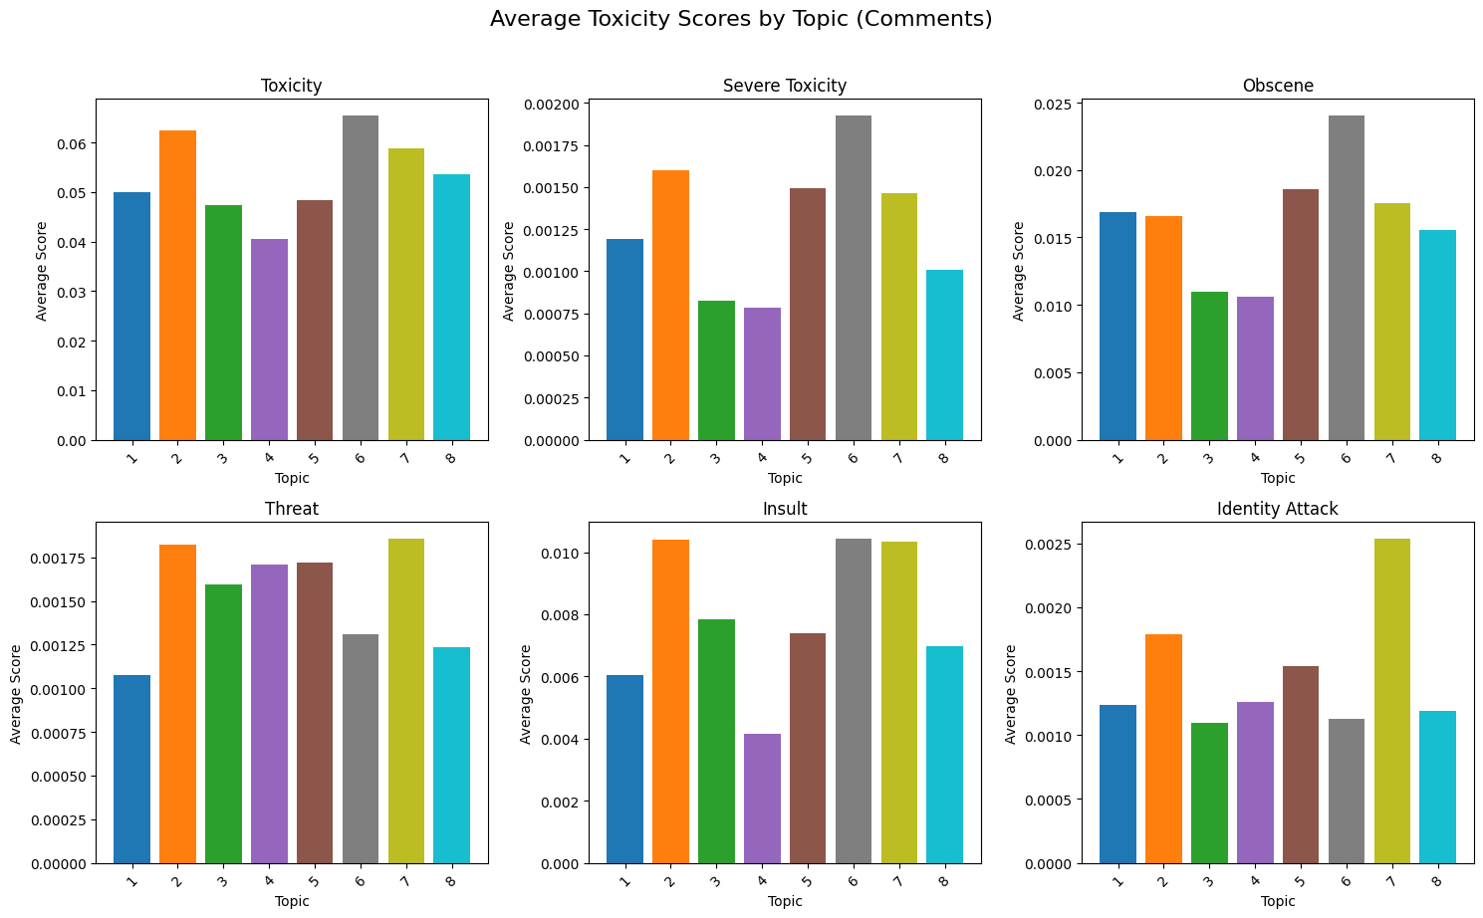
Average Toxicity Scores by Topic (Comments)

Slide 22
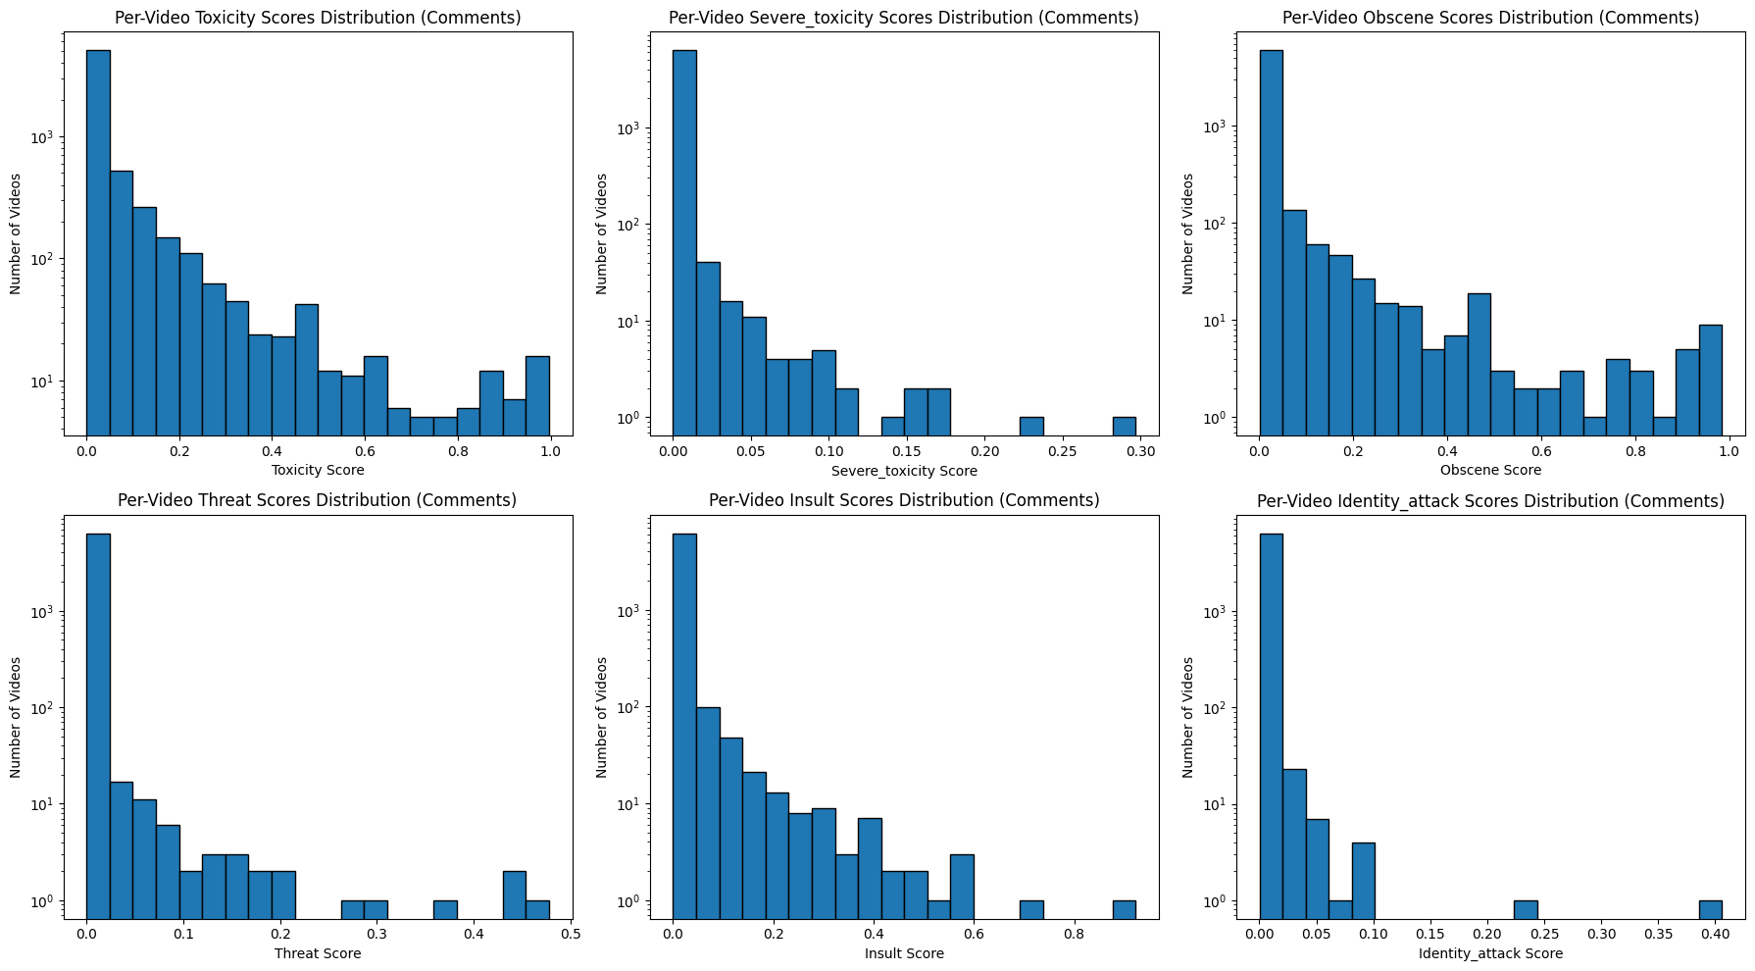
Per-Video Toxicity Scores Distribution (Comments)

Slide 23
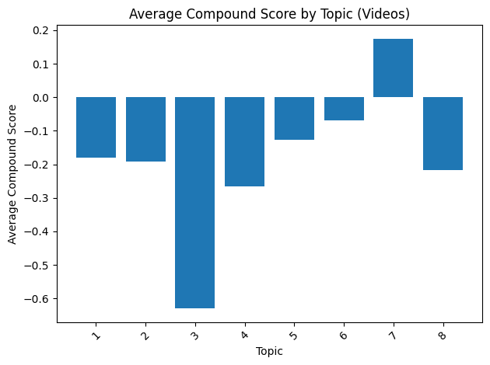
Average Compound Score by Topic (preprocessed text from videos)

Slide 24
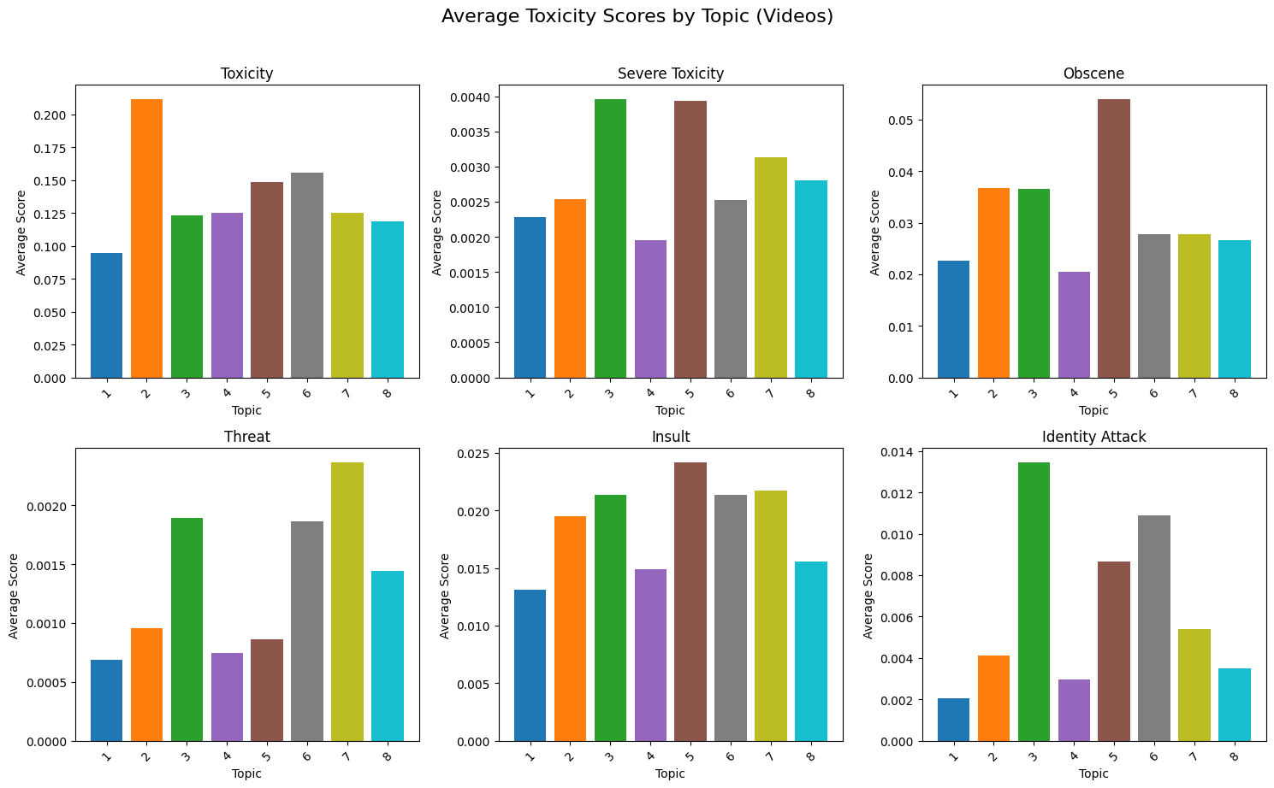
Average Toxicity Scores by Topic (preprocessed text from videos)

Slide 25
Week 10 – April 22
Activities:
Extracted comments for the next 1,500 video IDs (bringing the total to 10,000 video IDs).
Created box plots by topic for Sentiment and toxicity score distributions (from comments and video-level text).
Updated existing histograms of per‑video compound and toxicity scores (comments) by applying a log scale to the y‑axis.
Generated new log‑scaled histograms for video‑level sentiment and toxicity scores from preprocessed text.
Manually reviewed sample videos per topic to verify relevance and assess toxicity contextually.
Outcome:
Achieved clearer, more comparable visualizations of sentiment and toxicity metrics through log scaling.
Gained deeper insight into the distribution of emotional and toxicity signals at both comment and video‑text levels.
Validated topic assignments and ensured that toxicity metrics reflect real user interactions in context.

Slide 26
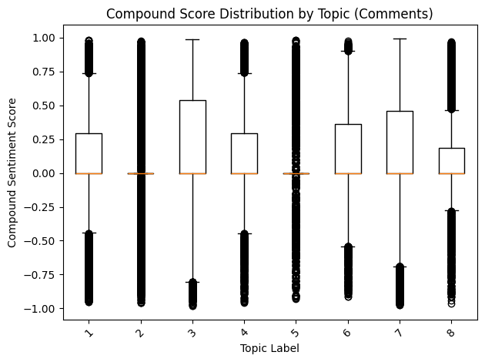
Compound Score Distribution by Topic (Comments)

Slide 27
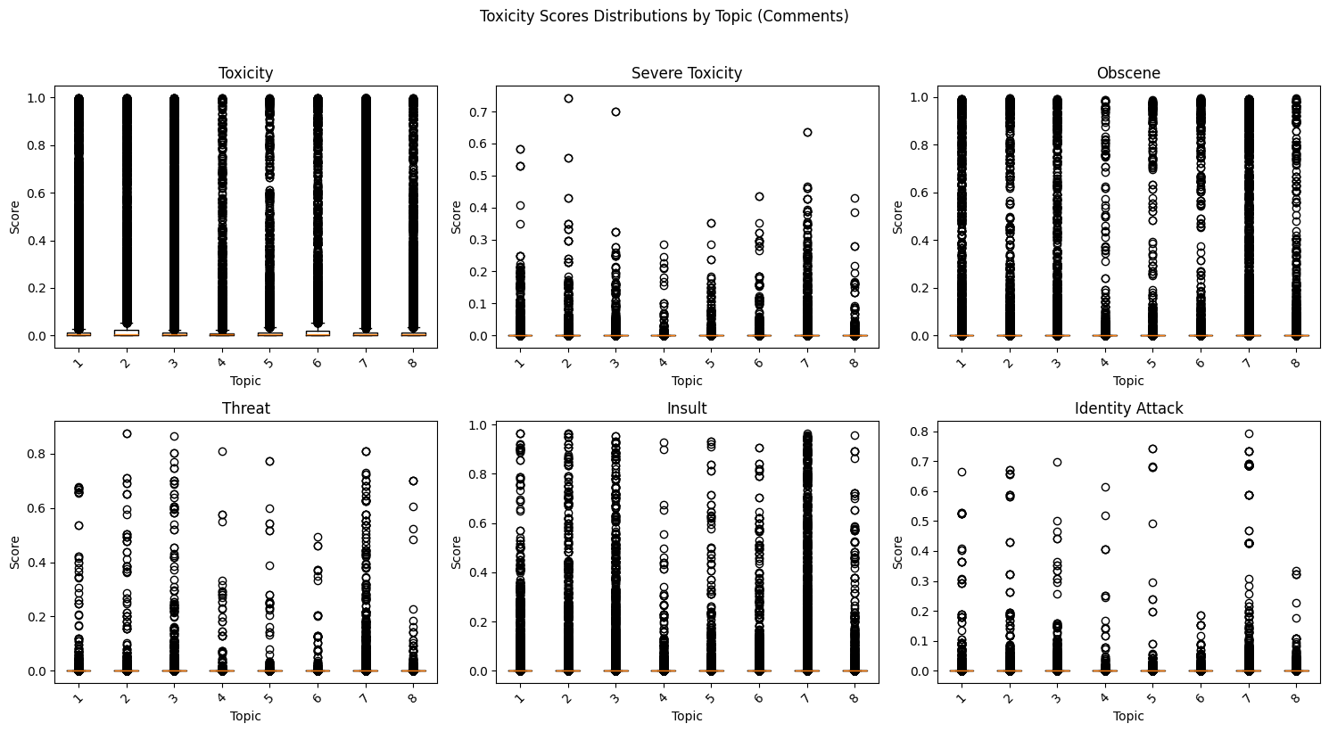
Toxicity Scores Distribution by Topic (Comments)

Slide 28
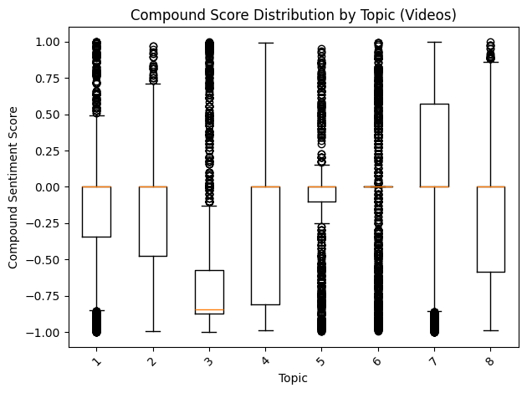
Compound Score Distribution by Topic (preprocessed text from videos)

Slide 29
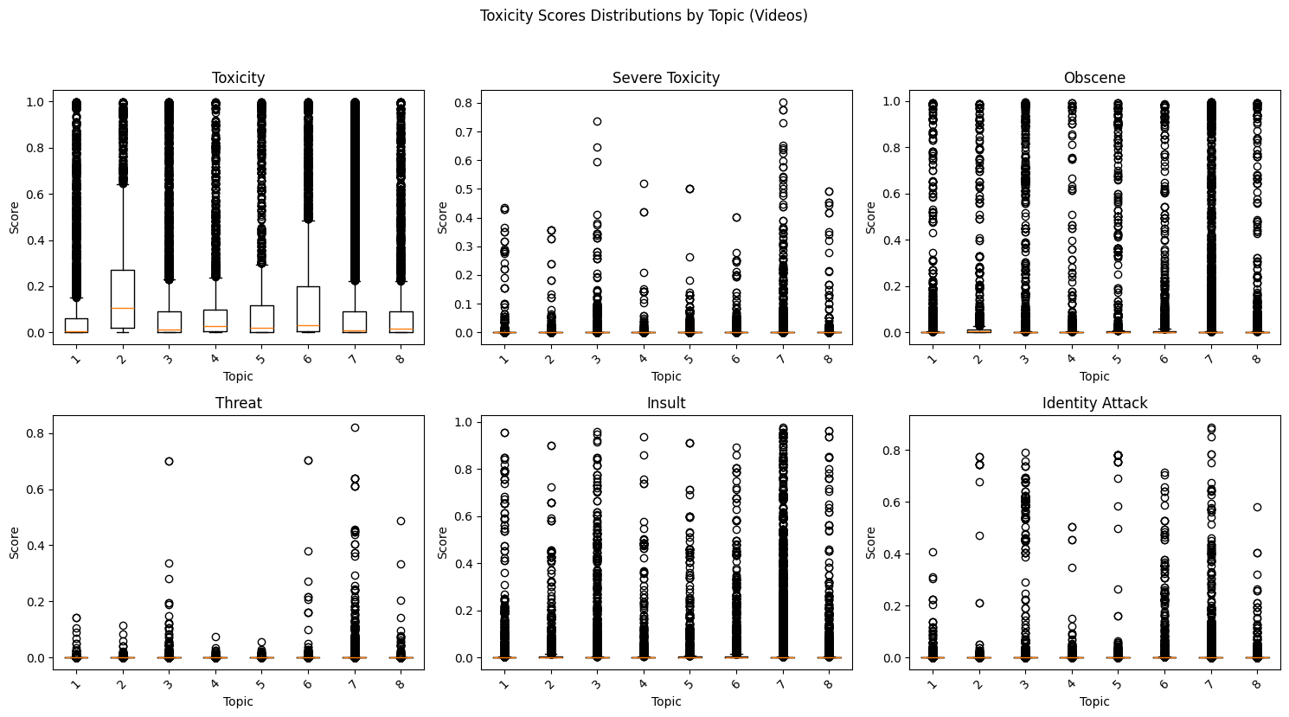
Toxicity Scores Distribution by Topic (preprocessed text from videos)

Slide 30
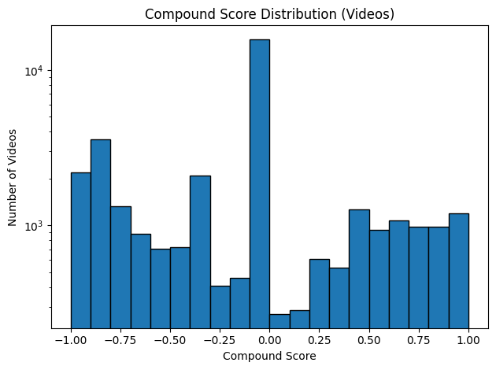
Compound Score Distribution (preprocessed text from videos)

Slide 31
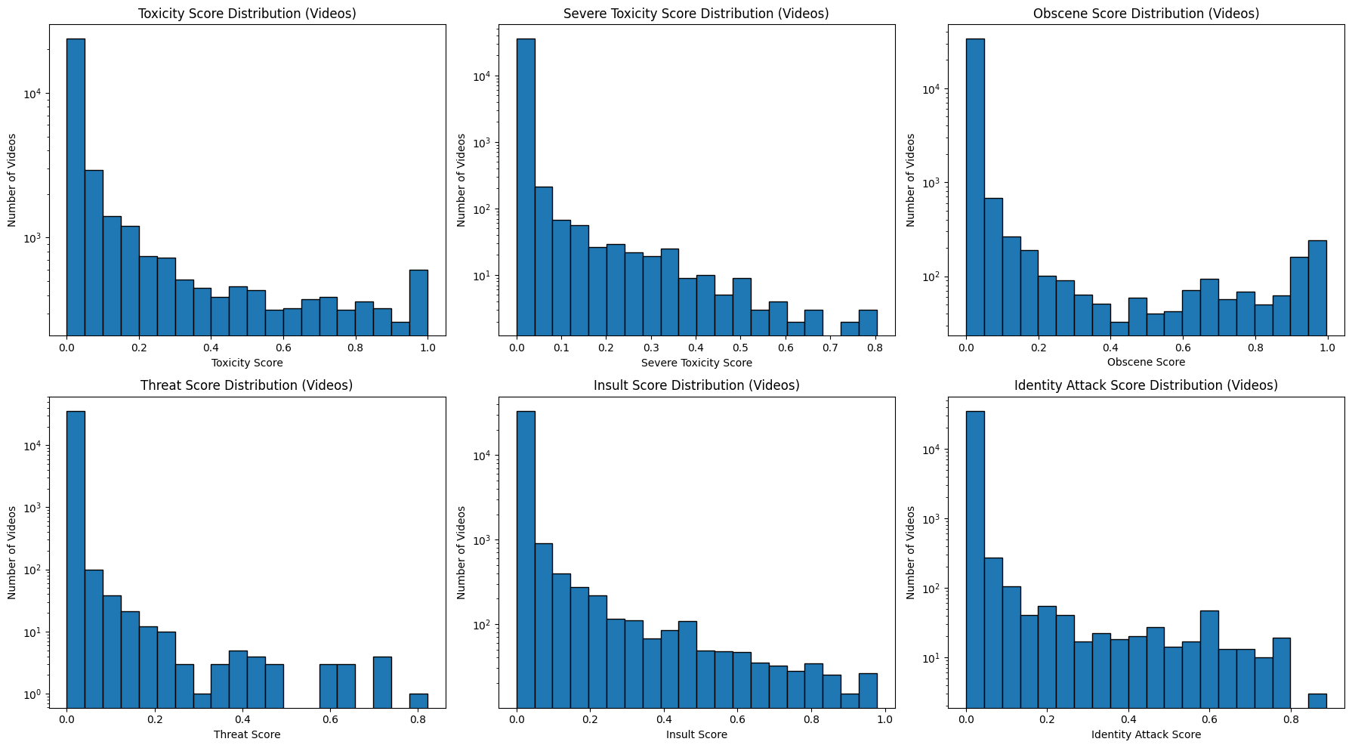
Toxicity Scores Distribution (preprocessed text from videos)

Slide 32
Sample videos per topic
Topic-1:
https://www.tiktok.com/@bbgrltyson/video/7228674442791062830
https://www.tiktok.com/@anxiousamy_/video/7373783390140583210
Topic-2:
https://www.tiktok.com/@._.vent_account_/video/7236389658509249794
https://www.tiktok.com/@unknxwn_sg/video/7239782309778525467
Topic-3:
https://www.tiktok.com/@jb_copeland/video/7230843412696616234
https://www.tiktok.com/@tamikaloco/video/7225604077990808858
Topic-4:
https://www.tiktok.com/@nikkirobbi/video/7234936122323864874
https://www.tiktok.com/@saviitees/video/7229069052688436526
Topic-5:
https://www.tiktok.com/@amor_elena_/video/7228906676441697578
https://www.tiktok.com/@fuckd_5.3/video/7240860560722595114

Slide 33
Sample videos per topic
Topic-6:
https://www.tiktok.com/@abarker092/video/7230750012123188522
https://www.tiktok.com/@tiffanyannsmith3/video/7226509216092114219
Topic-7:
https://www.tiktok.com/@kait00627/video/7236343015223119150
https://www.tiktok.com/@msvixen333/video/7244202649678138666
Topic-8:
https://www.tiktok.com/@ventforfree07/video/7230200993760202010
https://www.tiktok.com/@safe.spac3_4all/video/7225842682994707755

Slide 34
Week 11 – April 29
Activities:
Extracted comments for 2,000 more video IDs (totaling 12,000).
Switched to violin plots for better insight and visualized:
Compound and toxicity score distributions by topic (for both comments and videos).
Plotted histograms for compound score distributions by topic (comments and videos).
Uploaded final code and presentation to GitHub.
Outcome:
Enhanced interpretability of score distributions through more expressive visualizations.
Finalized and documented the project for submission and sharing.

Slide 35
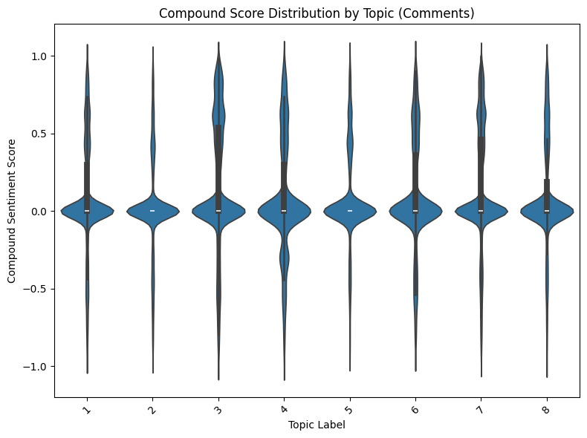
Compound Score Distribution by Topic (Comments)

Slide 36
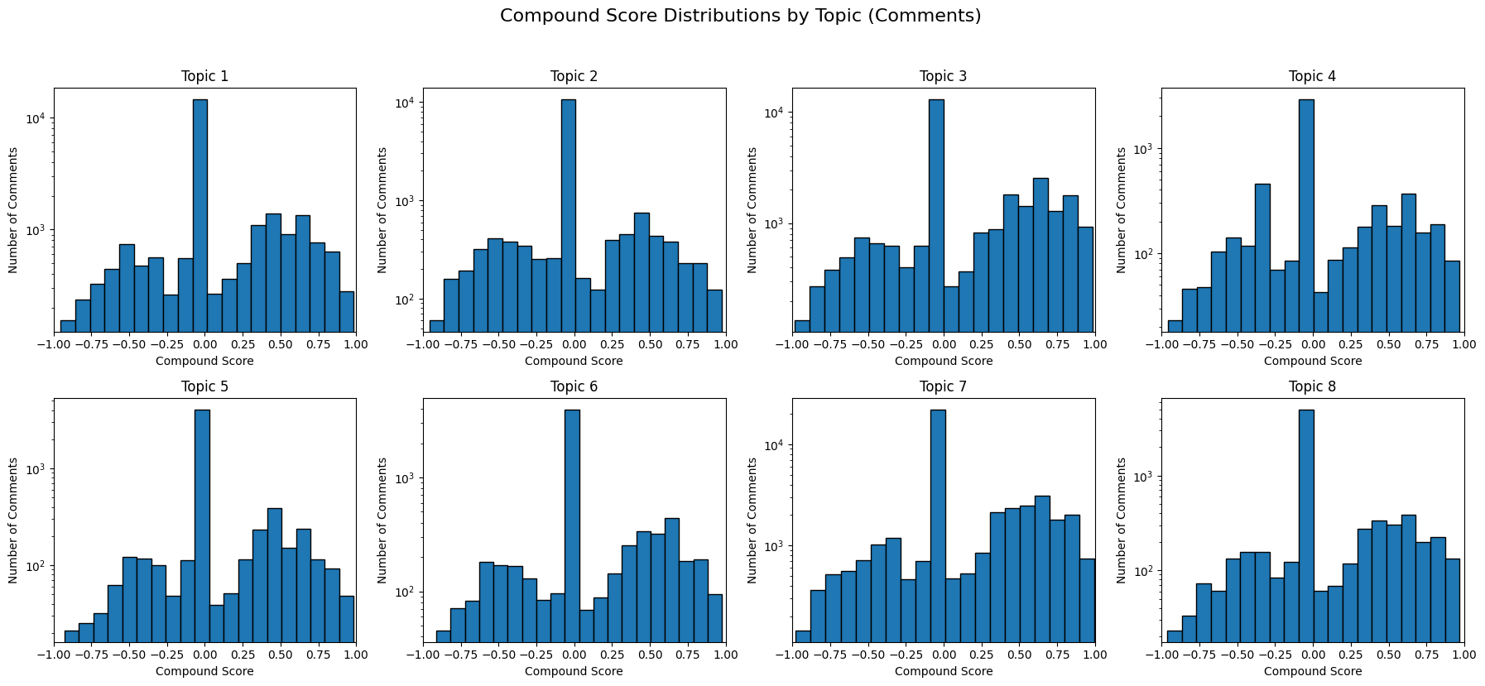
Compound Score Distribution by Topic (Comments)

Slide 37
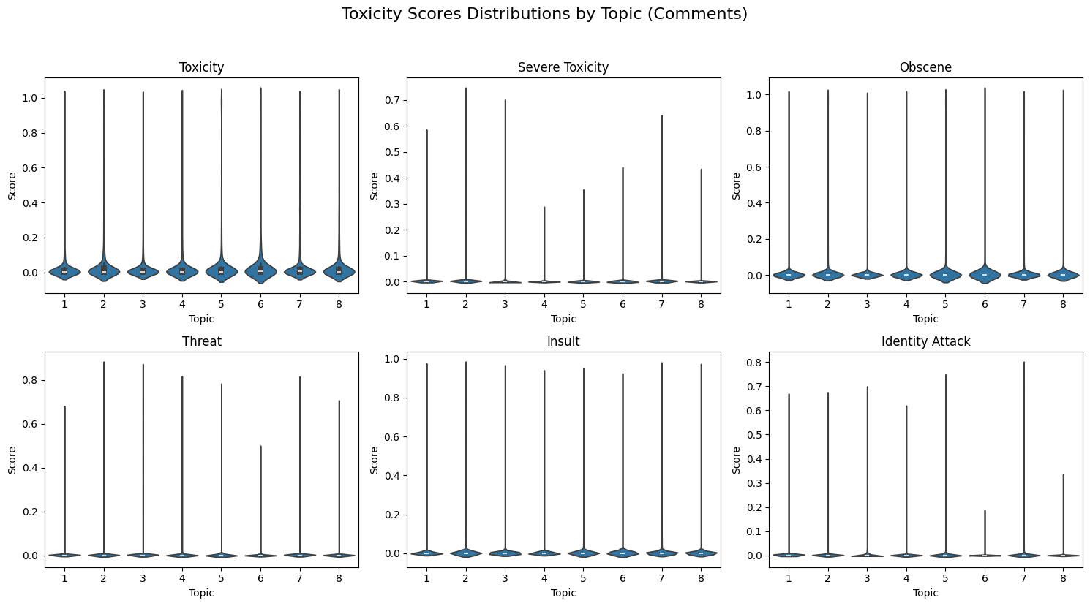
Toxicity Scores Distribution by Topic (Comments)

Slide 38
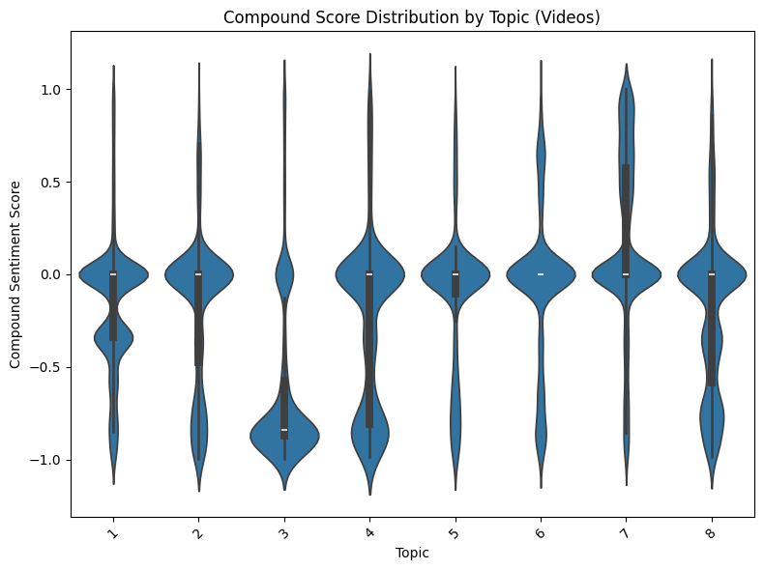
Compound Score Distribution by Topic (preprocessed text from videos)

Slide 39
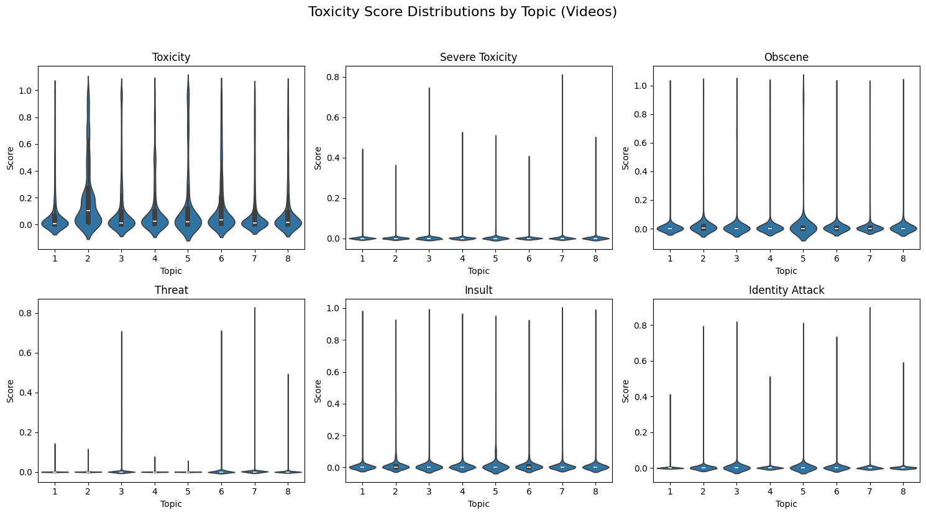
Toxicity Scores Distribution by Topic (preprocessed text from videos)

Slide 40
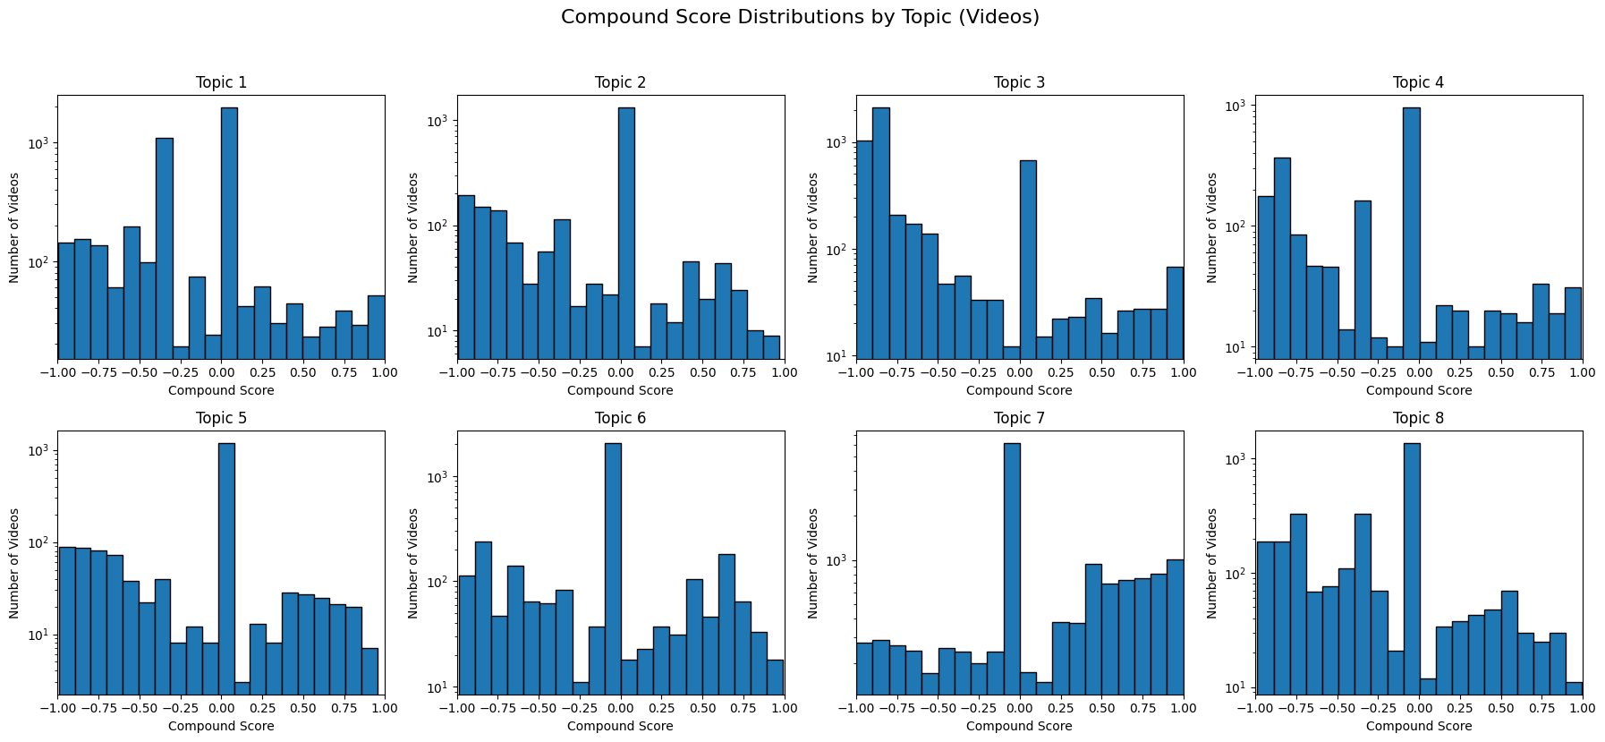
Compound Score Distribution by Topic (preprocessed text from videos)

